Slide 1







603: STATISTICAL MODELLING WITH DATA
Forecasting UEFA Champions League Team Success using Multiple Linear Regression

Slide 2

INTRODUCTION
The UEFA Champions League is Europe's premier club football tournament organized by the Union of European Football Associations (UEFA).
Features top football clubs from various European leagues competing for the prestigious title.
The tournament is known for its high level of competition and showcases some of the best talents and teams in world football.
It is a key event in the football calendar, attracting a global audience and significant media attention.
Motivation: Enhance strategic decision-making in sports organizations by analyzing factors affecting a team's win percentage, merging our passion for soccer for an engaging and insightful research experience.
Notes:
What is UEFA Champions League?
UEFA Champions League is Europe's premier club football tournament organized by the Union of European Football Associations, also known as UEFA.
ThE UCL features top football clubs from various European leagues competing for the prestigious title and is known for its high level of competition, and showcases some of the best talents and teams in the football world.
Our motivation in choosing this domain is to enhance strategic decision-making in sports organizations by help them analyzing factors that affects a team's winning percentage as well as merging our team member's passion for soccer for an engaging and insightful research experience.

Slide 3

objectives
Develop a multiple linear regression model to predict the win percentage of teams for their future games based on their past performance in the UEFA Champions League 2021/22 season.
Extend the analysis to include a model predicting possession percentage, recognizing its importance as a major contributing factor to winning in soccer.
Notes:
Objectives.
Our first objective for this project is to develop a multiple linear regression model that predicts the win percentage of teams for their future games based on their past performance in the UCL during 2021/2022 season.
And since we recognized possession percentage as a major contributing factor to winning a soccer game, we wanted to extend our analysis by building a second multiple linear regression model that predicts possession percentage of a team.

Slide 4

DATASET
The dataset contains 32 rows and 66 columns.
Each row represents a different soccer team.
The includes data of team names, team codes, wins, draws, losses, total points, qualification status, group, country code, goals, etc.
The dataset covers the historical performance data for each team in group stage for the UEFA Champions League for 2021/22 season. This includes their stage of exit in each of these seasons.
We fixed data-types, dropped irrelevant columns and created a win percentage column in a new dataset.
Notes:
Our dataset consists of 32 rows and 66 columns that was retrieved from Kaggle .
Each row in our dataset represents a different soccer team in the league.
The columns of our dataset includes data such as team names, team codes, wins, draws, losses, total points, qualification, status, group, country code, goals, etc
Our dataset covers teams's performance in the UCL for the 2021/2022 season as well as their stage of exit in the seasons.
We did a little bit of data cleaning for our dataset, we fixed the dat types of columns, dropped irrelevant columns and created a win percentage column.

Slide 5
METHODOLOGY
Model Selection:
Step-wise Model Selection
Forward Model Selection
Backward Model Selection
Best Subset Model Selection
Interaction & Higher Model Analysis
Assumption Checks:
Multicollinearity
Equal Variance
Linearity
Normality
Outliers
Notes:
For both of our models, in our model selection process, we did stepwise, forward, backward and best subset model selection. Followed by the Interaction and Higher Order model analysis.
During our assumption checks, we tested out the model's multicollinearity, equal variance, linearity, normality as well as the outliers.

Slide 6
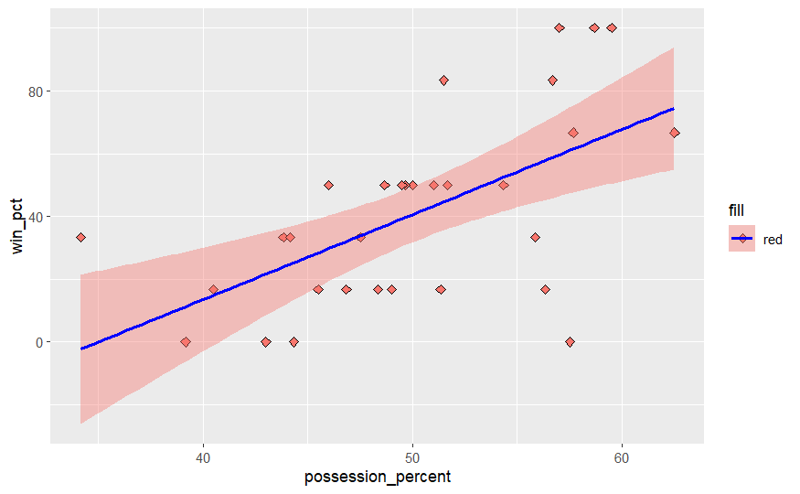
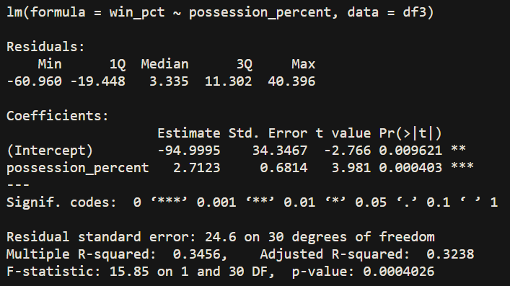
Two models: Win Percentage and possession percentage
Notes:
We will be building two models. One for predicting win percentage and one for possession percentage. The second model was taken into consideration since teams with higher possession tend to win more games and our main goal is to forecast a team's success.

Slide 7
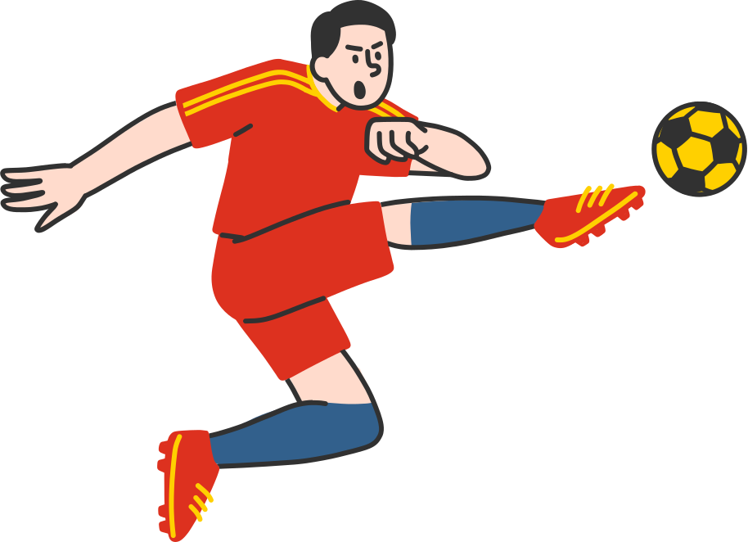
win percentage model

Slide 8
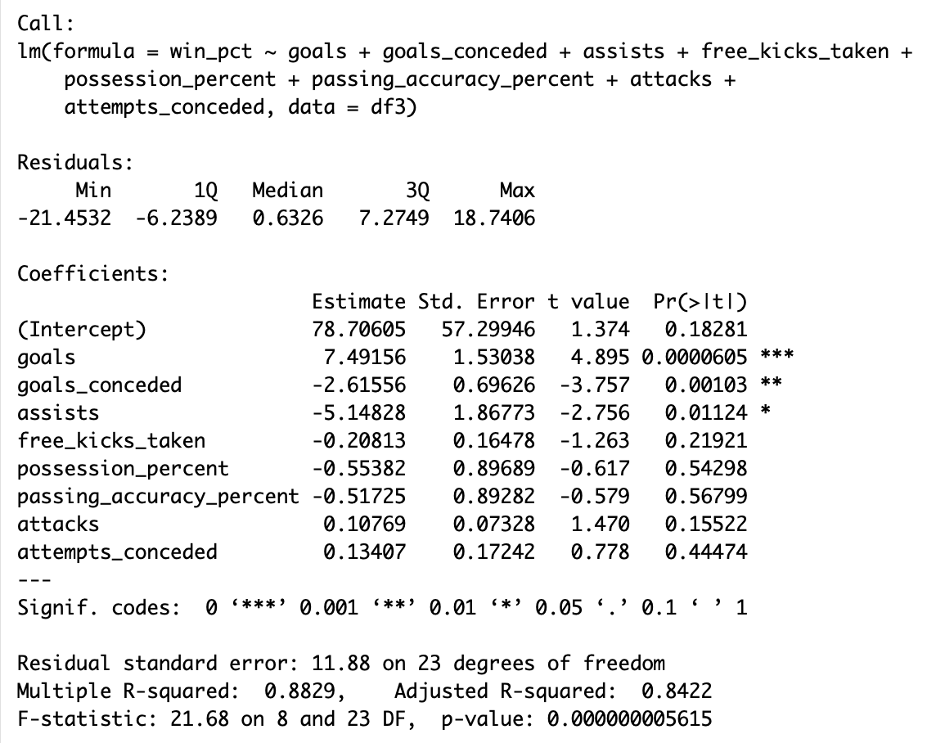
Starting model
Notes:
When we tried using full model, we got all Nan values because we had a large number of variables.
So to counter that we checked single variables significance individually and got to a starting point to predict a team's win percentage.
We had 8 independent variables here but only 3 of them were significant at alpha 0.05 which were goals, goals conceded and assists.

Slide 9
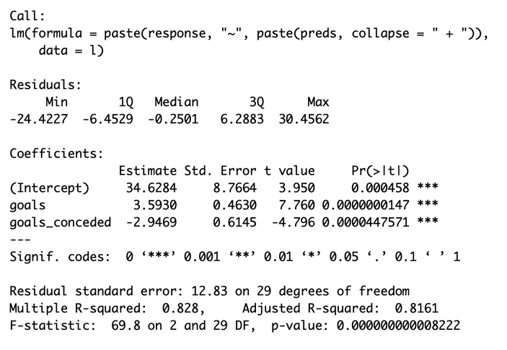
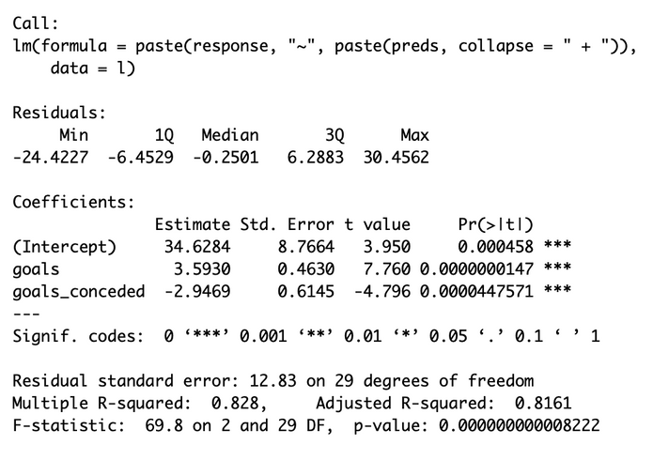
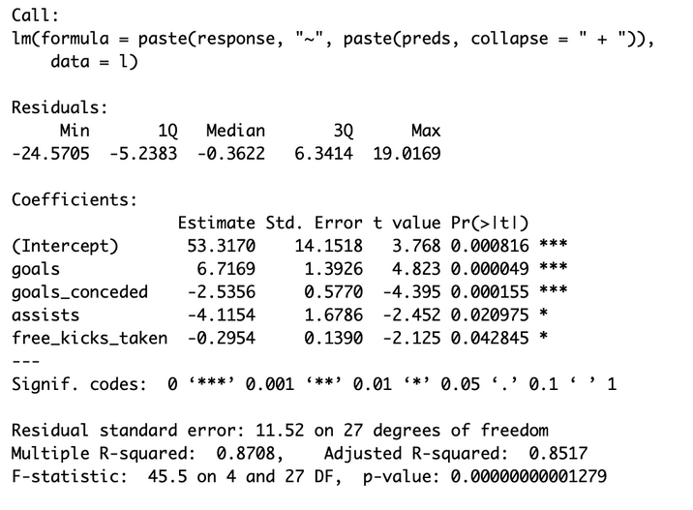
INDEPENDENT model
Stepwise Model
Forward Model
Backward Model
Notes:
After that we used stepwise, forward and backward selection methods to find an optimal model. The backward model had the highest adjusted R-squared of 0.8517 and RMSE of 11.52 with goals, goals conceded, assists and free kicks taken as significant predictors.

Slide 10
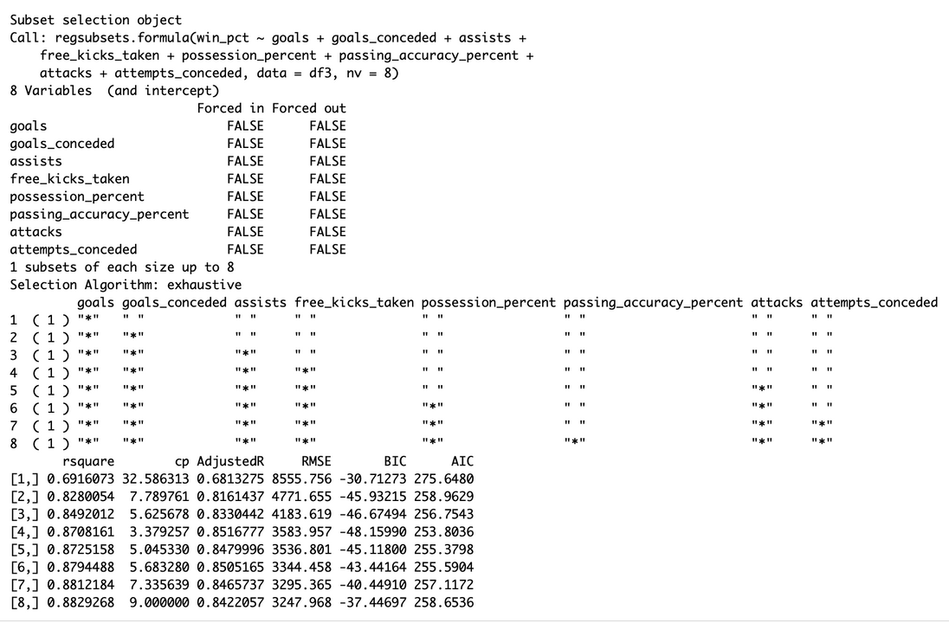
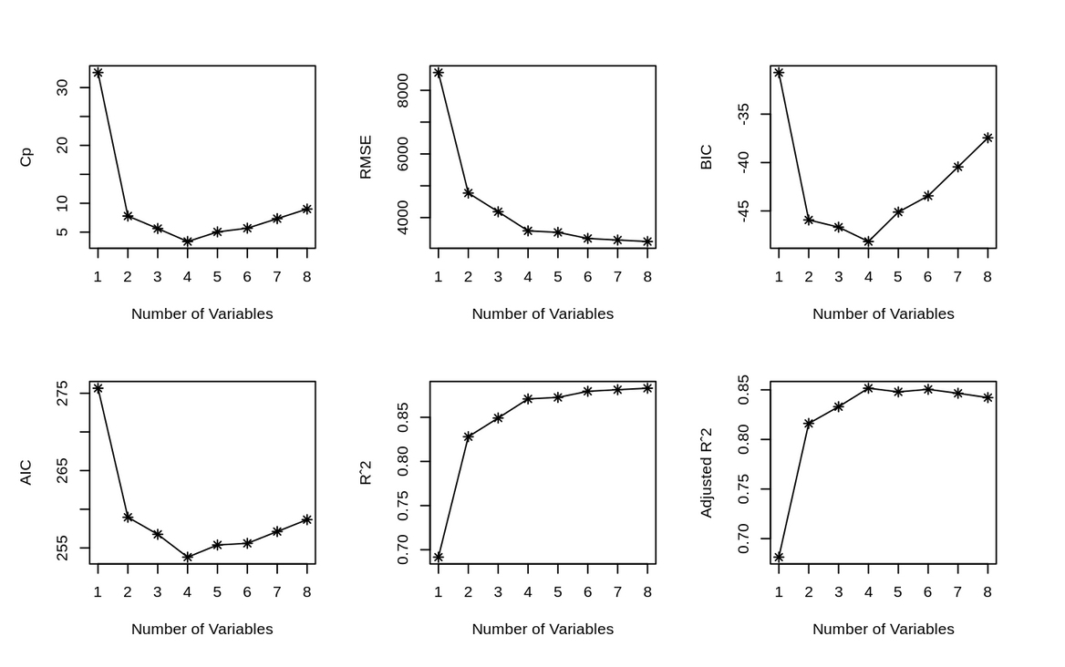
best subset model
Based on the All Subsets approach, it appears that the model containing 4 variables has the lowest values for CP, BIC, AIC, and other relevant metrics, making it the most optimal choice. Therefore, we will proceed with the final independent model comprising these four variables.
Notes:
And then we used the All Subsets approach and found that the model with the same 4 predictors had the lowest CP, BIC, AIC and other relevant metrics so this was the most optimal choice. Therefore, we moved forward with this model.

Slide 11
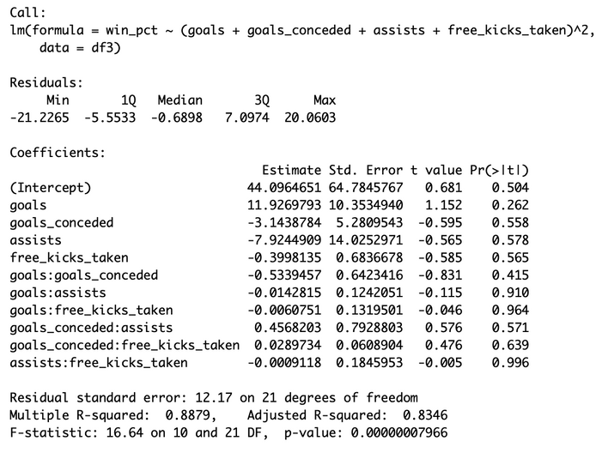
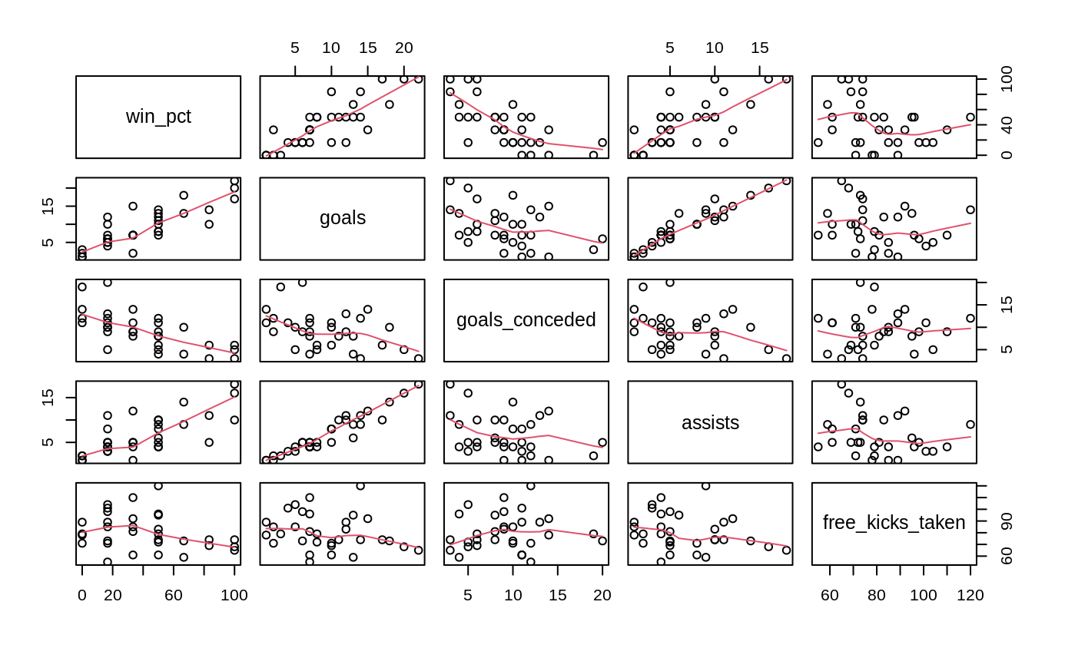
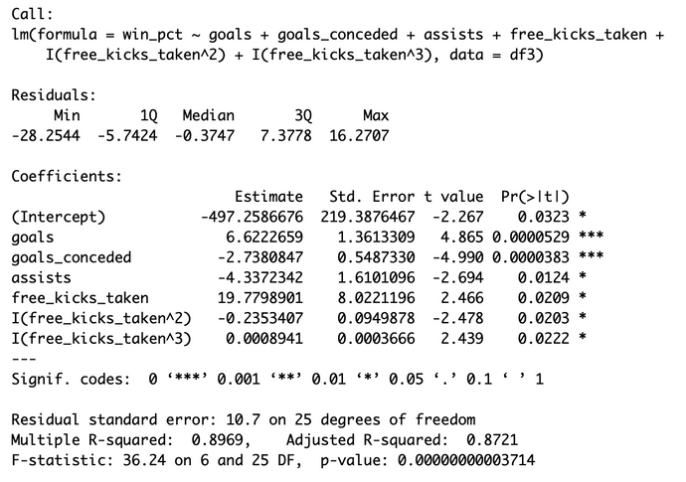
InteractiON & higher ORDER MODELS
Interaction Model
Higher Order Model
Notes:
We tried finding significant interactions but failed to find any. We also tried using higher order terms and found that taking the cube of free kicks taken improved our model with a higher Adjusted R Squared of 0.8721 and lower RMSE of 10.7
Now that we have perfected our model, can we perform predictions through it?
Well not yet, we still have to check if our assumptions actually hold true for this model.

Slide 12
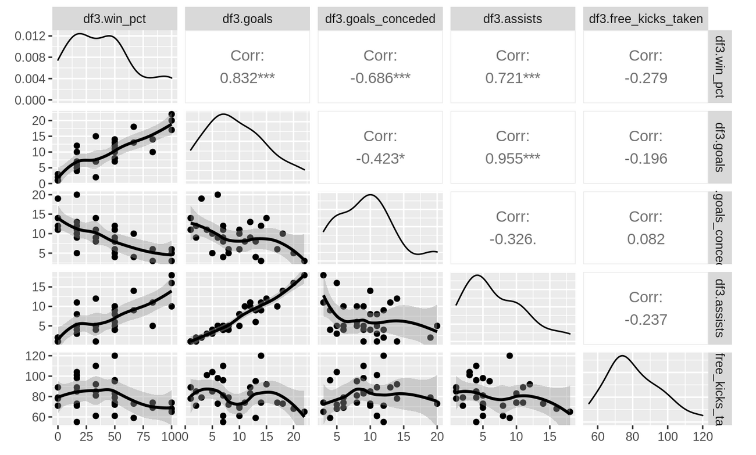
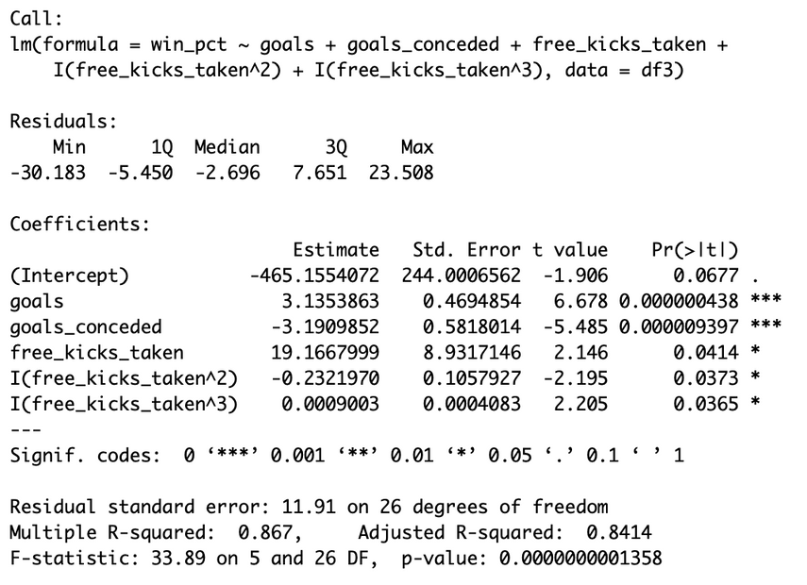
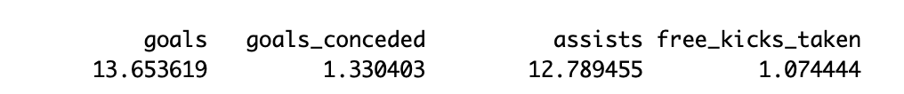
MULTIcollinearity
Multicollinearity exists between goals and assists in the pair-wise scatterplots and VIF analysis, with a correlation of 0.955 and VIF values of around 12 . Therefore, we removed assists from the model.
Updated Model
Notes:
To start off our analysis, we first check for multicollinearity and through the correlation plots and VIF we observe 1 multicollinearity between goals & assists.
It means that both of the variables are essentially providing similar input to our prediction and we don't want duplicate inputs overfitting our model, so the best foot forward is to remove one of them from our model.
Upon removing assists from the model we observe slight decline in the R2, but that's necessary to satisfy multicollinearity assumption.

Slide 13
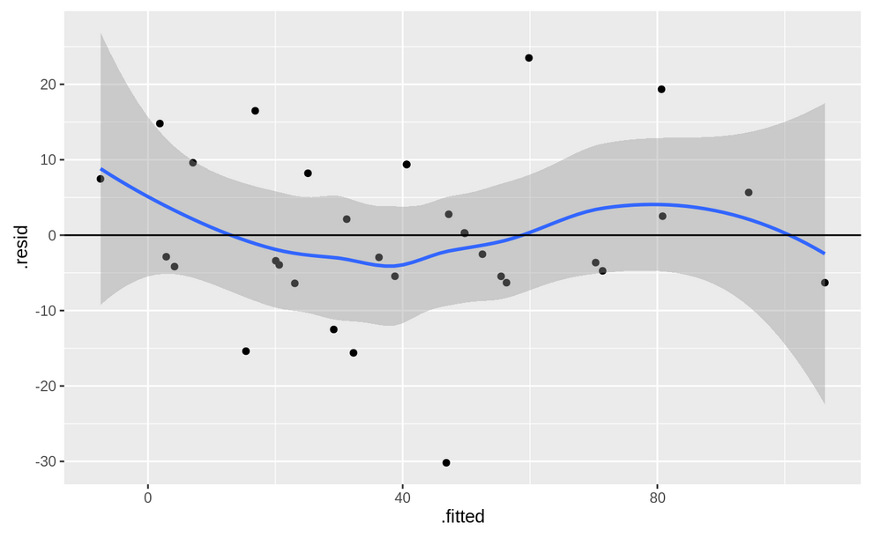
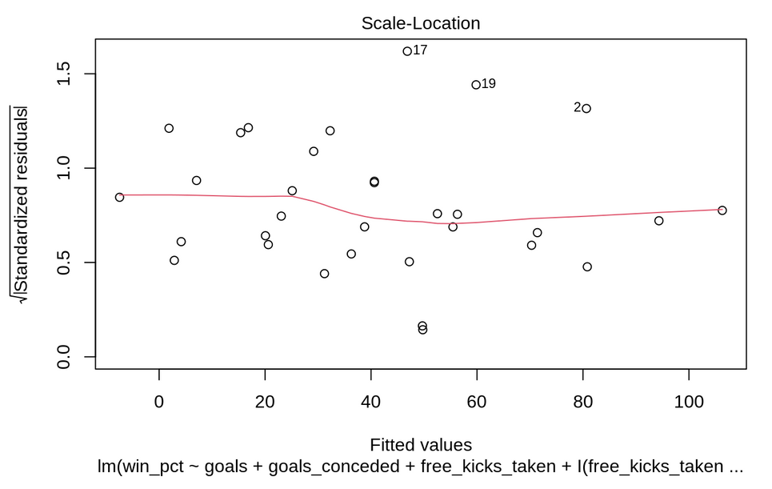
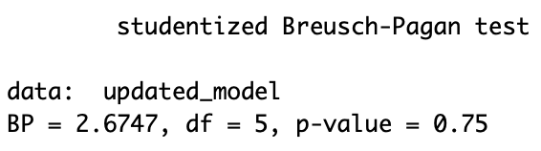
equal variance & linearity
Residual vs Fitted
Standardized Residual vs Fitted
The residual plots showed no heteroscedasticity, which was confirmed by the Breusch-Pagan test, with a p-value of 0.75, so we fail to reject the null hypothesis that heteroscedasticity is not present.
Notes:
Now we check the Equal Variance AKA "Non-Heteroscedasticity" & Linearity.
Through the residual vs fitted plots we don't see any pattern and this is further proved by the BP test as we get pvalue of 0.75.
So, both of these assumptions hold true for our updated model.

Slide 14
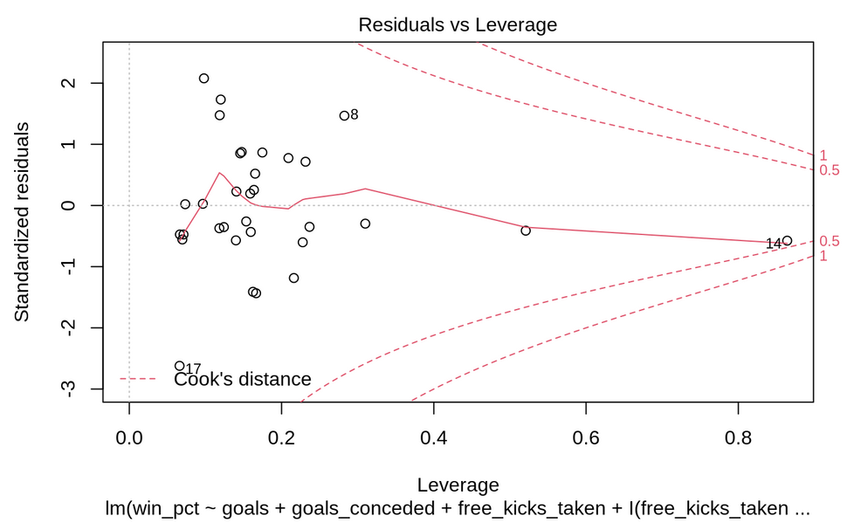
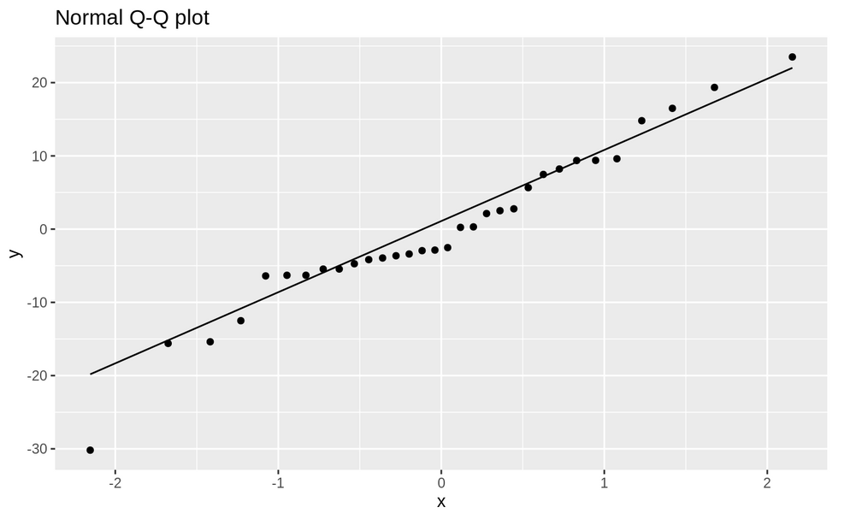
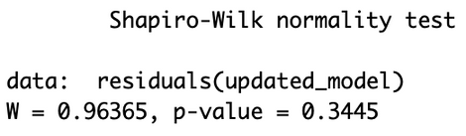
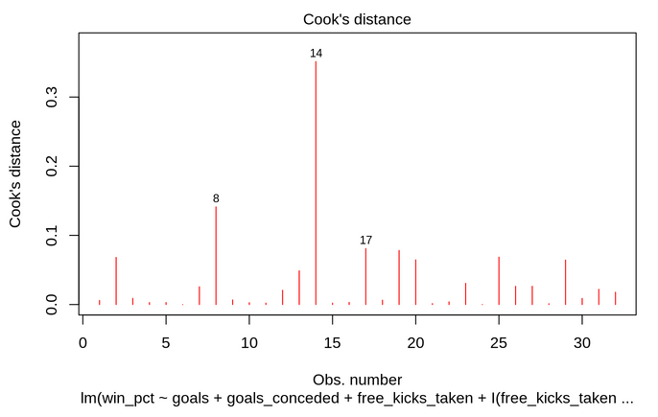
normality & outliers
Normality:
Through the Q-Q plot and Shapiro test we conclude that Normality assumption is valid in this case as we get a p-value=0.34 > alpha=0.05, so we fail to reject the null hypothesis that normality is present.
Outliers:
Through the Cook's distance and Residual vs Leverage plot we can't find any clear outliers.
Notes:
Here we check if the model satisfies the normality assumption and if there are any influential outliers to be removed.
Again through the QQ plot and Shapiro test we conclude normality and through residual vs leverage plot we find only 1 leverage point and that too isn't crossing the 0.5 cooks distance meaning it doesn't influence the results in a different way.

Slide 15
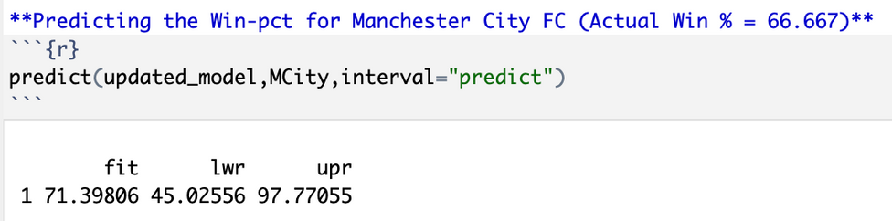
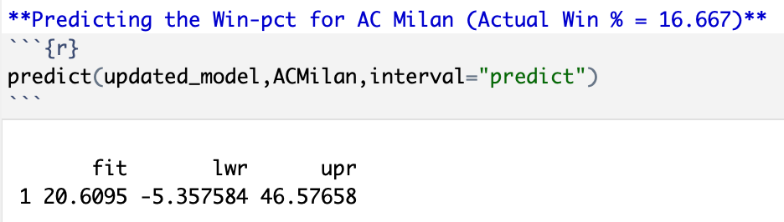
final model
After fulfilling all the necessary assumptions, we have arrived at our final model:
Adj-R-Squared: 0.84
RSE: 11.91
Prediction
After analyzing the tournament performance of both Manchester City and AC Milan, we employed this model to predict their win rates in upcoming matches. Upon comparing the predicted values to the actual values, it's evident that the model performed well.
Notes:
Now that all the assumptions have been fulfilled we can proudly show our final model which has Adj R2 of 0.84 and low RSE of 11.91.
Now this is the part I was most excited about.
We got the actual data for two teams Manchester City and AC Milan which had quite different performance as manchester had a win % of 66.67 and AC Milan on the other hand had just 16.67.
Using our model we predicted the win % 71.4 and 20.6 for both teams, respectively.
These results are pretty close to the actual values so we know our model would be helpful for any of you guys who are interested in soccer.

Slide 16
posSession percentage model

Slide 17
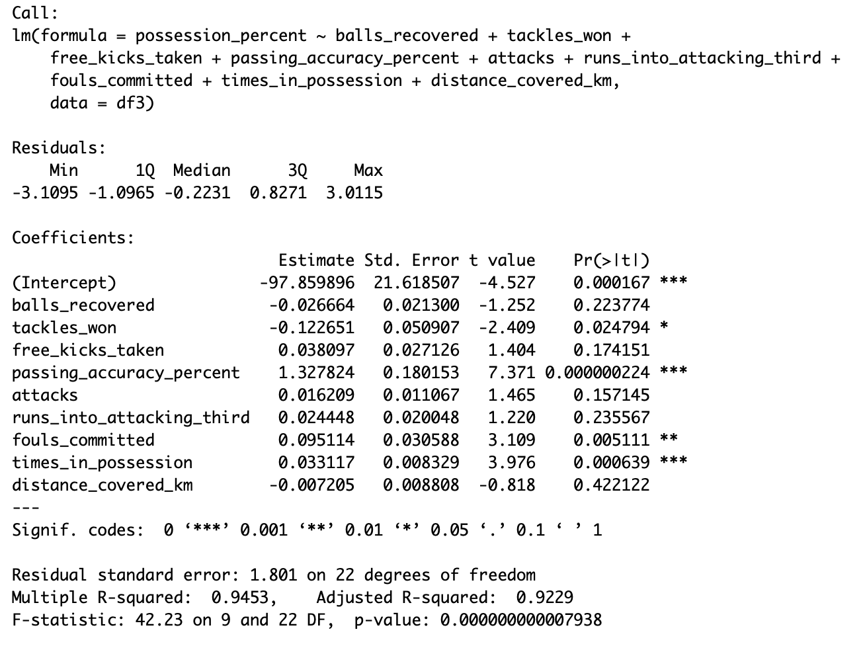
Starting model
Notes:
Starting model with 9 independent variables but only 4 of them being significant predictors, we got here the same way we did with the first win percentage model.

Slide 18
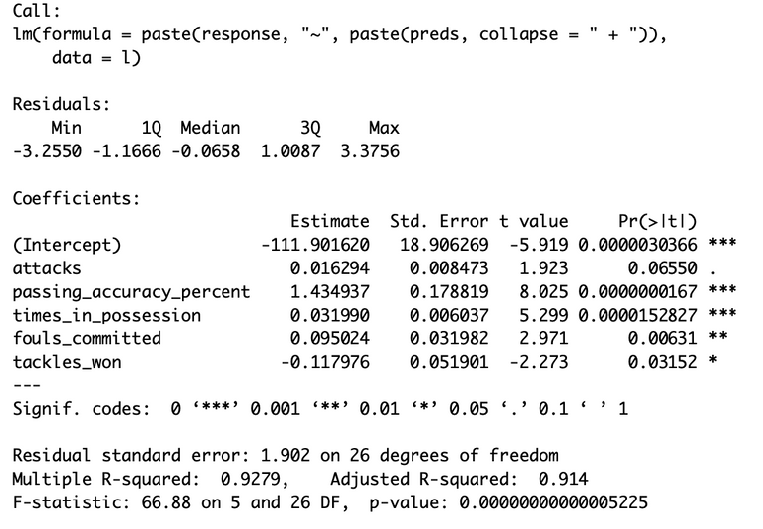
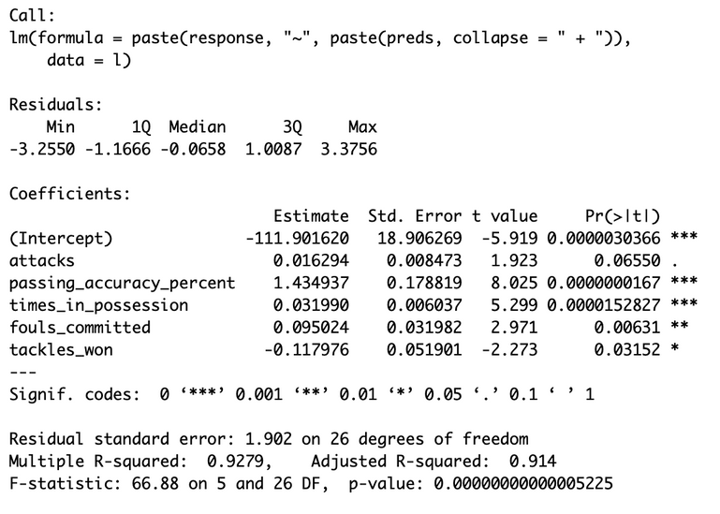
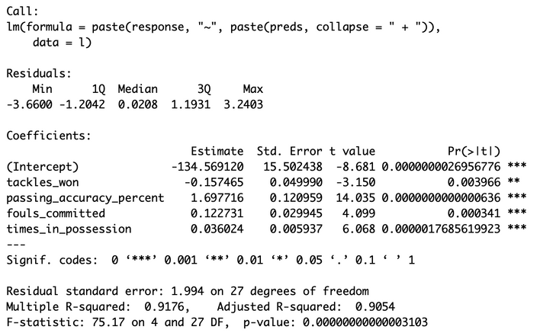
INDEPENDENT model
Stepwise Model
Forward Model
Backward Model
Notes:
Stepwise and forward model came up with better models at an adjusted r value of 0.914

Slide 19
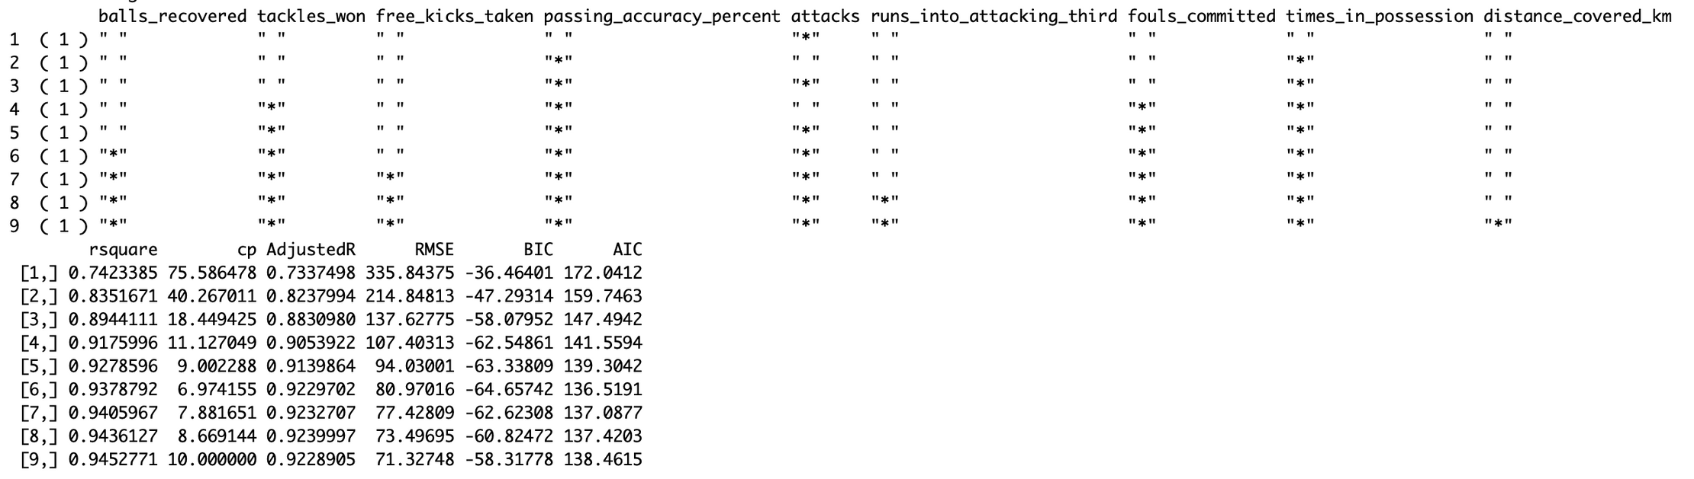
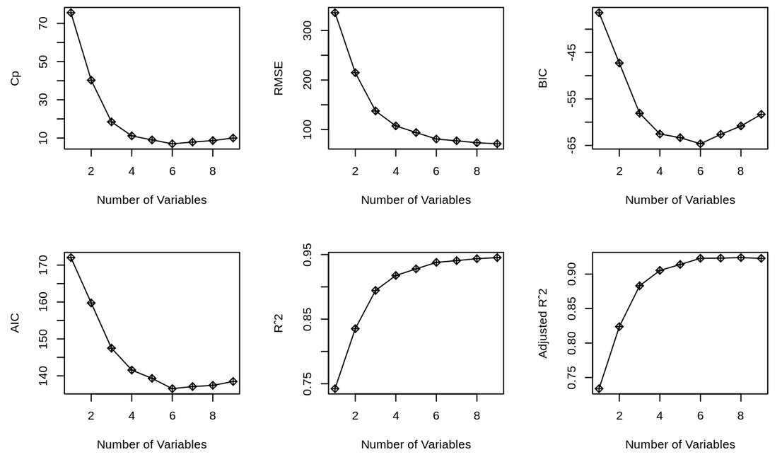
best subset model
Based on the All Subsets approach, it appears that the model containing six variables has the lowest values for CP, BIC, AIC, and other relevant metrics, making it the most optimal choice. Therefore, we will proceed with the final independent model comprising these six variables.
Notes:
then with the subset approach we got closer to a better model with 6 predictors having the most optimal combination of CP, BIC, AIC, Adjusted r squared and RMSE. so we go ahead with this model.

Slide 20
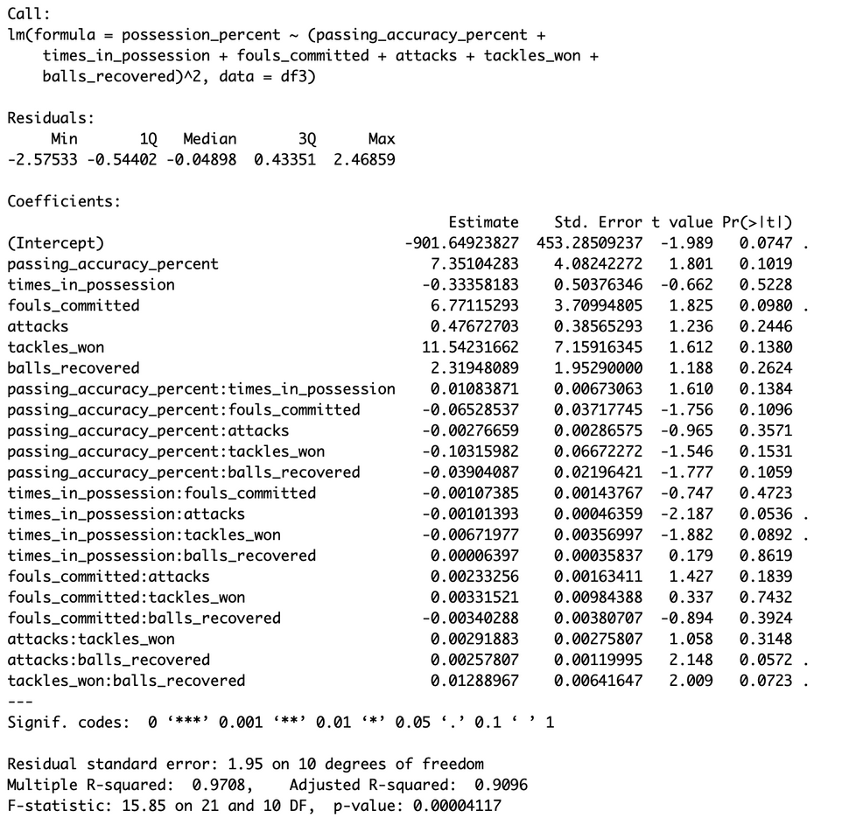

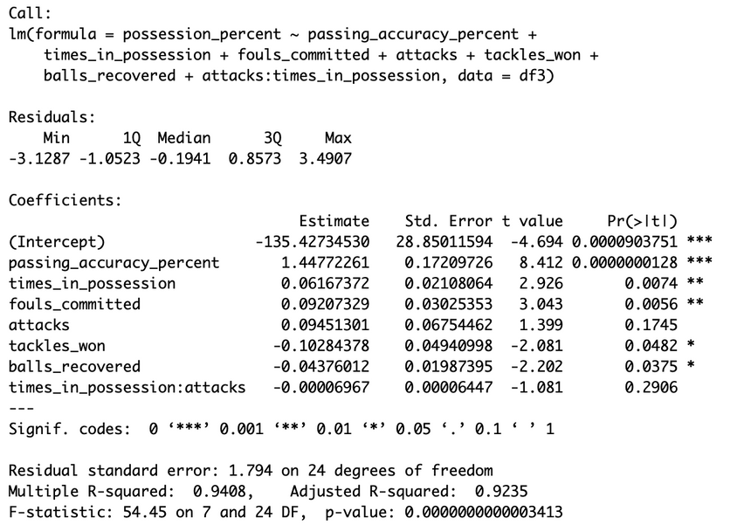
InteractiON MODEL
Reduced Interaction Model
The results of F-test shows a P-value > 0.05, hence the interactions are not significant in the model.
Notes:
We tried finding significant interactions but failed to find anything worth mentioning backed by the f-test which we used at every model comparison step!

Slide 21
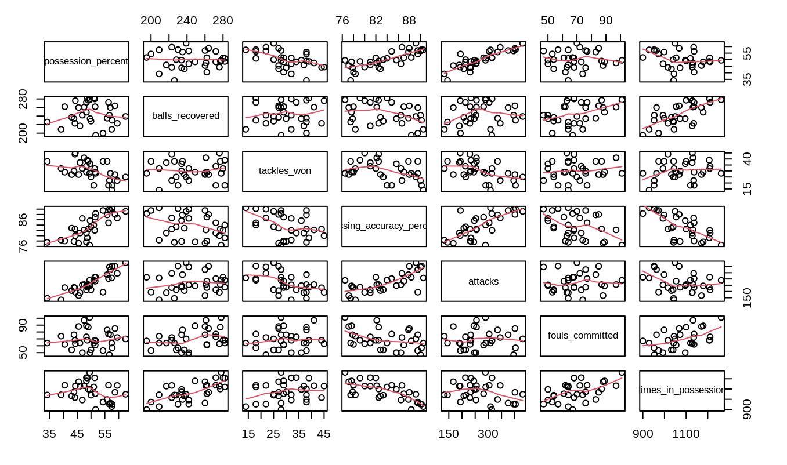
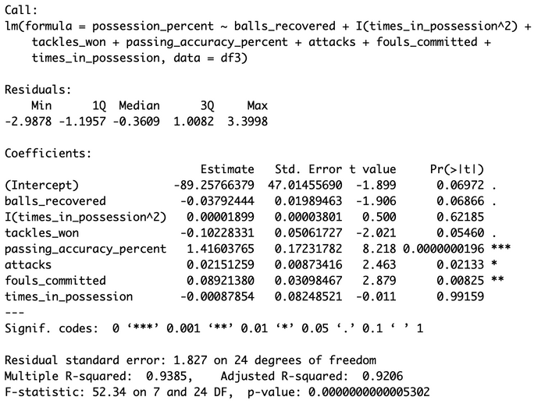
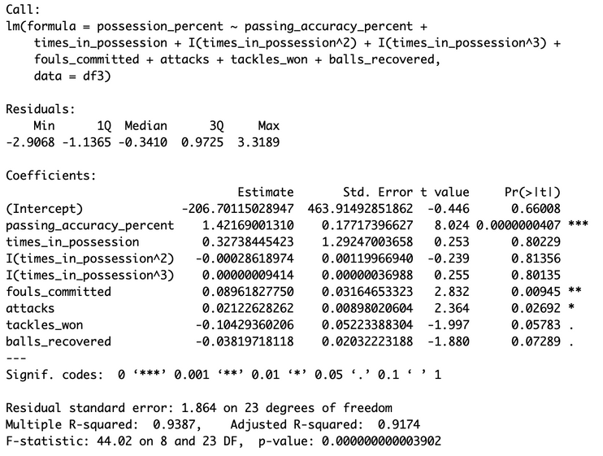
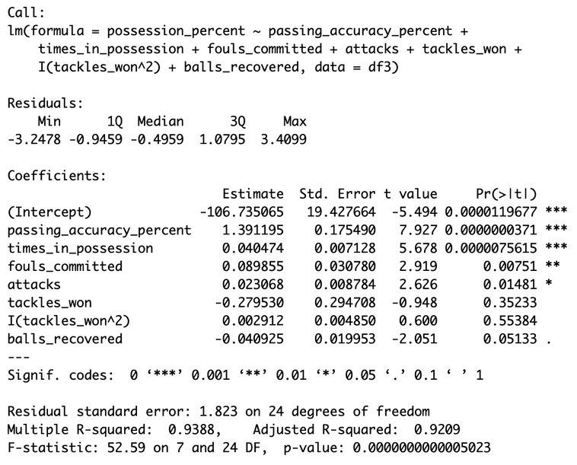
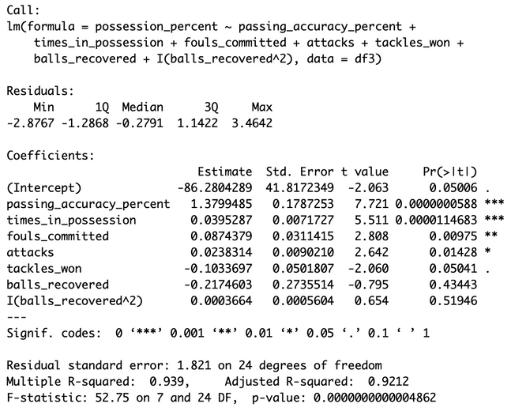
HIgher order MODEL
balls_recovered
tackles_won
sing_accuracy_perc
attacks
fouls_committed
times_in_possession
Multiple trials have shown that the inclusion of higher order variables does not improve the model. In fact, it results in a decrease in the Adjusted R-squared value. Therefore, the initial model is recommended as the final model for predictive purposes.
Notes:
We also tried using higher order terms and unlike the win percentage model we failed to find and significant improvement to the reduced model.
settling on the best model from the all subset approach, we'll move on to assumption checks.

Slide 22
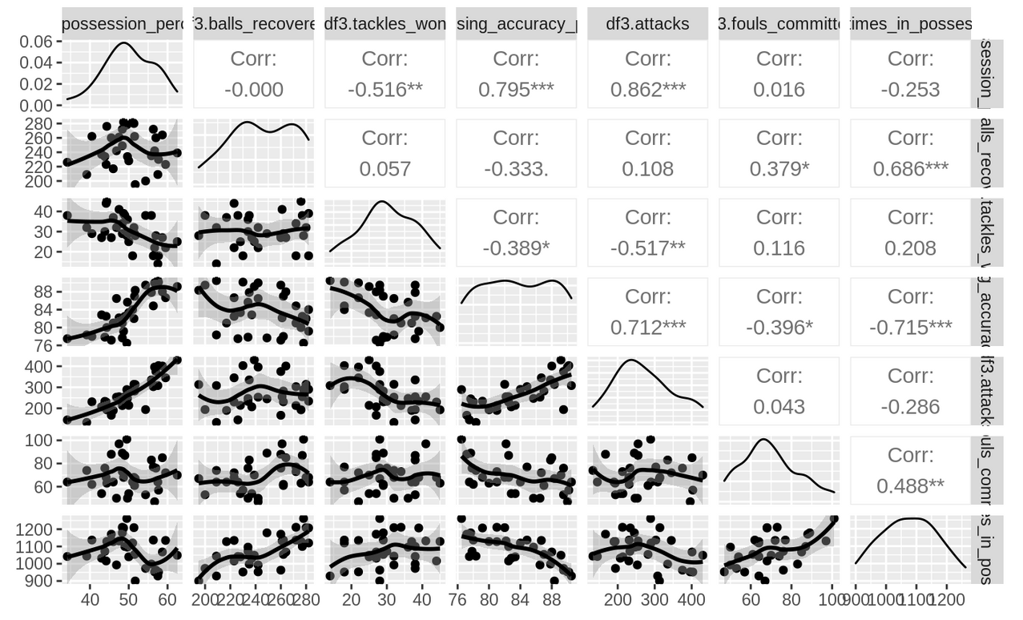
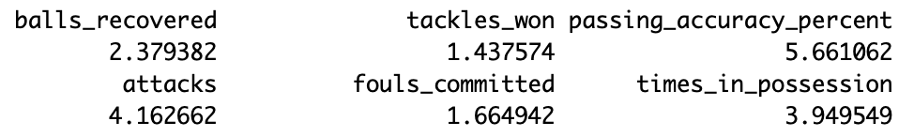
MULTIcollinearity
The final model was assessed for multicollinearity using pair-wise scatterplots and VIF, which confirmed the absence of collinearity. The predictors did not show a correlation greater than 0.8, and the VIF values were low (less than 6), indicating no collinearity among the predictors.
Notes:
First up, multicollinearity. using pair-wise scatterplots and the (VIF) method it revealed no significant collinearity issues demonstrating independence from each other.

Slide 23
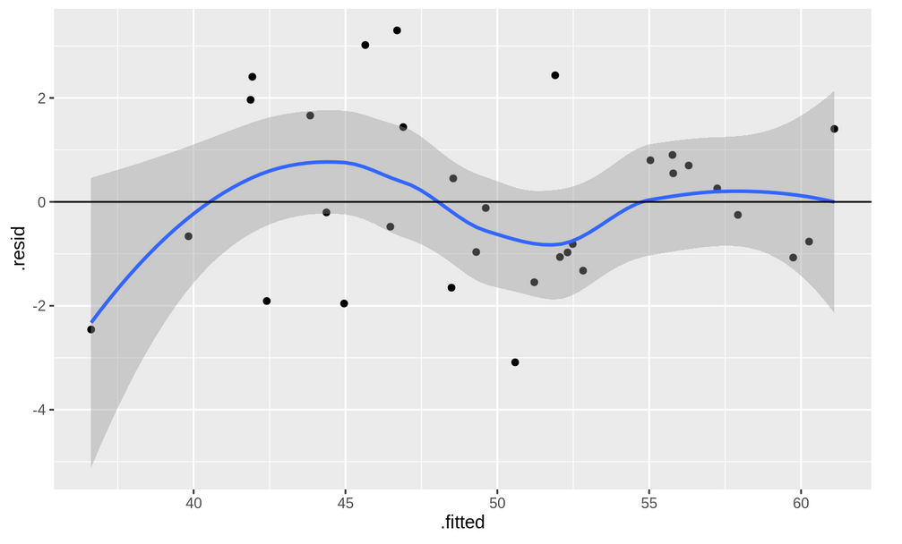
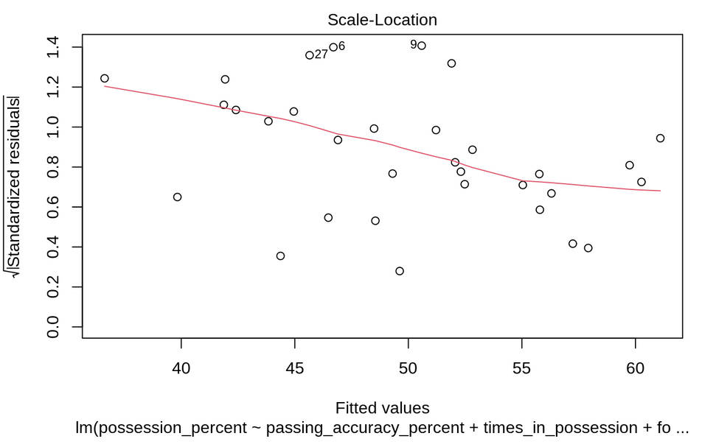
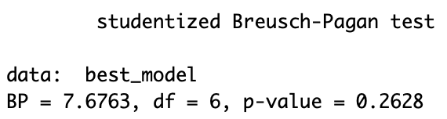
equal variance & linearity
Residual vs Fitted
Standardized Residual vs Fitted
Through the residual plots we observed a random scatter pattern which indicates no heteroscedasticity and this was also confirmed through Breusch-Pagan Test as we get pvalue=0.26 and we fail to reject the null hypothesis of Equal Variance Assumption.
Notes:
Next equal variance and linearity. The residual plots revealed a random scatter, indicating the absence of heteroscedasticity and further backed up by the results of the Breusch-Pagan Test. With a p-value of 0.26, we couldn't reject the null hypothesis, which supports the Equal Variance Assumption in our model and ensures reliability.

Slide 24
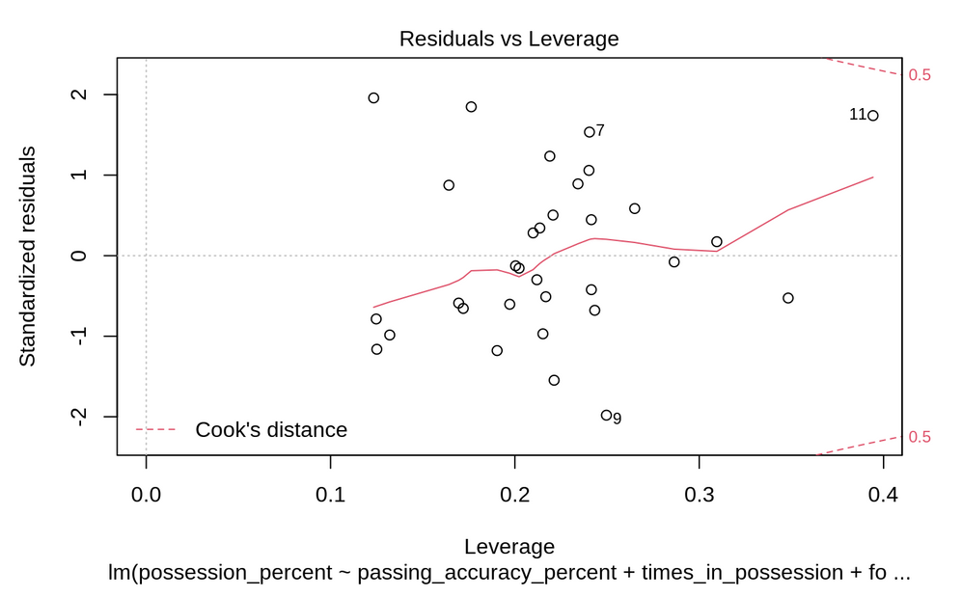
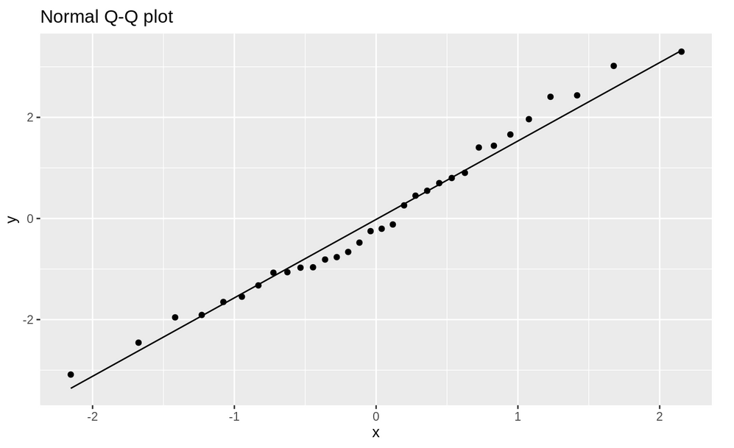
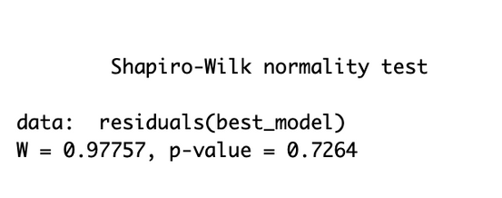
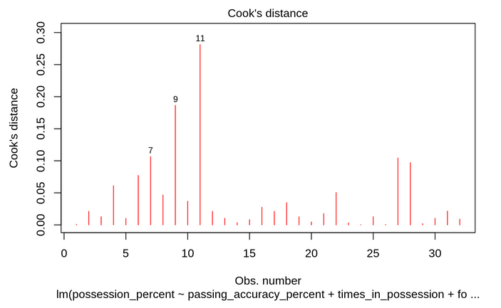
normality & outliers
Normality:
Through the Q-Q plot and Shapiro test we conclude that Normality assumption is valid in this case as we get a p-value=0.73 > alpha=0.05, so we fail to reject the null hypothesis that normality is present.
Outliers:
Through the Cook's distance and Residual vs Leverage plot we can't find any clear outliers.
Notes:
Our model's normality was checked through the Q-Q plot and the Shapiro-Wilk test which had a p-value of 0.73, exceeding the alpha level of 0.05. leading us to fail to reject the null hypothesis, and assume normality.
We also investigated for outliers using Cook's distance and the Residual vs. Leverage plot. These did not reveal any distinct outliers, indicating a stable and reliable dataset for our model.

Slide 25
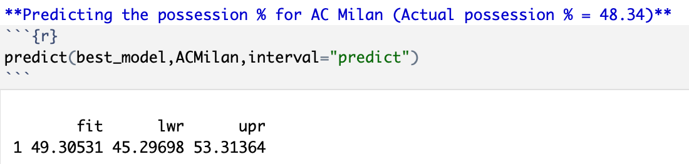
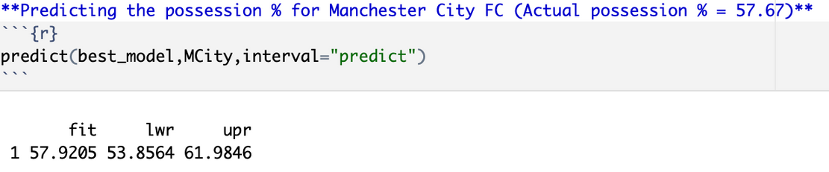
final model
Upon satisfying all the required assumptions, our final model is:
Adj-R-Squared: 0.92
RSE: 1.79
Prediction
After analyzing the tournament performances of both Manchester City and AC Milan, we used this model to predict their respective possession percentages. Upon comparing the predicted outcomes to the actual results, it's evident that our model performed exceptionally well.
Notes:
Now that we're done with the assumption checks we can finally test our final model with 6 independent variables which has an adj-r-squared of 0.9235, and RSE of 1.794
We got the same teams, Manchester City and AC Milan, but now predicted their possession percentage and compared it with their actual results.
Our model predicted AC Milan to have a 49.31% possession % compared to the actual possession which was 48.34% , so incredibly close. The Man City prediction was even closer at 57.92 % possession vs the 57.67% possession they actually had. about less than 0.3% off from the actual percentage
So in conclusion we have 2 very accurate models we can trust thanks to our various model construction methods and assumption checks. Which we can use to predict a team's success in terms of wins and possession% in matches to come.

Slide 26
references
Olalekan, G. (n.d.). UEFA Champions League 2021/22 [Data set]. Kaggle. https://www.kaggle.com/datasets/ganiyuolalekan/uefa-champions-league-202122/data

